Slide 1
Patterns
Unit 1 Lesson 10

Slide 2
Patterns
Students will be able to:
Analyze patterns and relationships
Key Vocabulary:
Patterns
Rules
Number patterns

Slide 3
Patterns
If we contract a set of elements or numbers in which all these elements or numbers are related to each other in a specific rule, then this rule or manner is called the pattern.
To construct a pattern, we have to know about some rules. To know about the rule for any pattern, we have to understand the nature of the sequence and the difference between the two successive terms.

Slide 4
Patterns
Sample Problem 1: Fill in the missing numbers.
a.
The rule for the pattern shown is +7.
$$4, ______, 18, 25, _______, ……………..$$

Slide 5
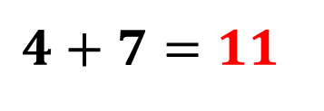
Patterns
Sample Problem 1: Fill in the missing numbers.
a.
The rule for the pattern shown is $+7$.
$$4, ______, 18, 25, _______, ……………..$$
$$4+7=11$$
$$11+7=18$$
$$18+7=25$$
$$25+7=32$$
$$4, 11, 18, 25, 32, …………….$$

Slide 6
Patterns
Sample Problem 1: Fill in the missing numbers.
b.
The rule for the pattern shown is $∗10$.
$$10; ___; 1,000;____;100,000;1,000,000 …………$$

Slide 7
Patterns
Sample Problem 1: Fill in the missing numbers.
b.
The rule for the pattern shown is $∗10$.
$$10; ___; 1,000;____;100,000;1,000,000 …………$$
$$10∗10=100$$
$$100∗10=1,000$$
$$1,000∗10=10,000$$
$$10,000∗10=100,000$$
$$100,000∗10=1,000,000$$
$$10; 100; 1,000;10, 000;100,000;1,000,000 ……$$

Slide 8
Patterns
Sample Problem 2: Find the rule for the following table of values.
a.
$$n$$ | $$1$$ | $$2$$ | $$3$$ | $$4$$ | $$5$$ | $$6$$ | $$7$$
 | $$15$$ | $$18$$ | $$21$$ | $$24$$ | $$27$$ | $$30$$ | $$37$$

Slide 9
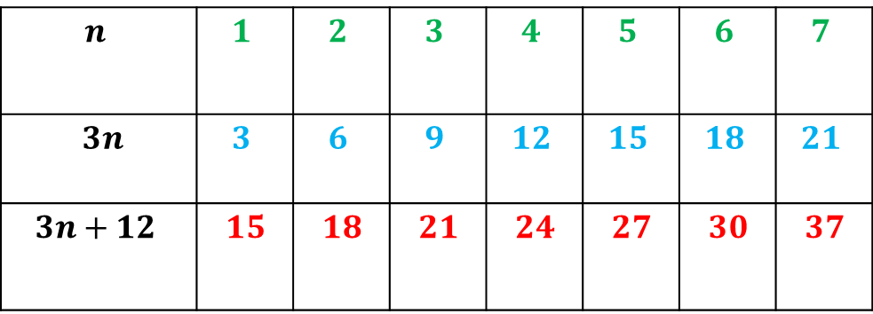
Patterns
Sample Problem 2: Find the rule for the following table of values.
a.
$$n$$ | $$1$$ | $$2$$ | $$3$$ | $$4$$ | $$5$$ | $$6$$ | $$7$$
$$3n$$ | $$3$$ | $$6$$ | $$9$$ | $$12$$ | $$15$$ | $$18$$ | $$21$$
$$3n+12$$ | $$15$$ | $$18$$ | $$21$$ | $$24$$ | $$27$$ | $$30$$ | $$37$$
$$∗3$$
$$+12$$
$$+3 +3 +3 +3 +3 +3$$
The difference between successive values is always 3. The rule is of the form $3n+12$

Slide 10
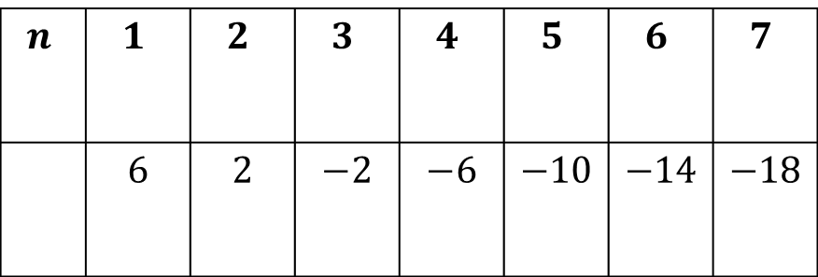
Patterns
Sample Problem 2: Find the rule for the following table of values.
b.
$$n$$ | $$1$$ | $$2$$ | $$3$$ | $$4$$ | $$5$$ | $$6$$ | $$7$$
 | $$6$$ | $$2$$ | $$−2$$ | $$−6$$ | $$−10$$ | $$−14$$ | $$−18$$

Slide 11
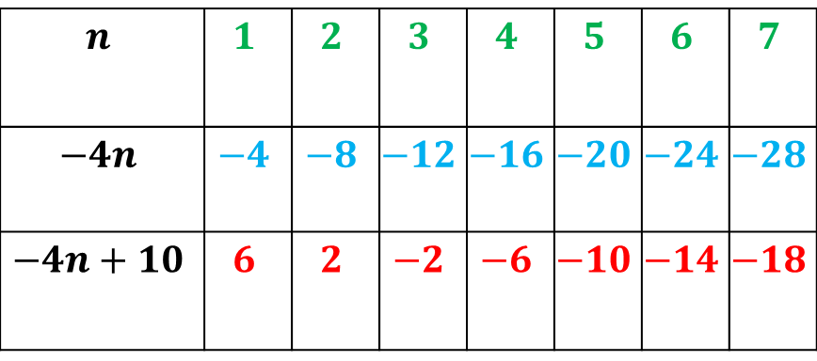
Patterns
Sample Problem 2: Find the rule for the following table of values.
b.
$$n$$ | $$1$$ | $$2$$ | $$3$$ | $$4$$ | $$5$$ | $$6$$ | $$7$$
$$−4n$$ | $$−4$$ | $$−8$$ | $$−12$$ | $$−16$$ | $$−20$$ | $$−24$$ | $$−28$$
$$−4n+10$$ | $$6$$ | $$2$$ | $$−2$$ | $$−6$$ | $$−10$$ | $$−14$$ | $$−18$$
$∗$-4
$$+10$$
$$−4 −4 −4 −4 −4 −4$$
The difference between successive values is always -4. The rule is of the form$−4n+10$

Slide 12
Patterns
Number Patterns
Algebraic Patterns are number patterns with sequences based on addition or subtraction. In other words, we can use addition or subtraction to predict the next few numbers in the pattern, as long as two or more numbers are already given to us.
The value added each time is called the common difference.

Slide 13
Patterns
Sample Problem 3: Find the common difference and the next number.
a.
$$1, 5, 9, 13, ……….$$

Slide 14
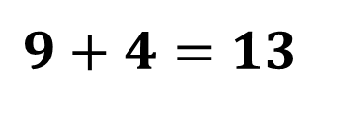
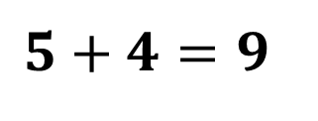
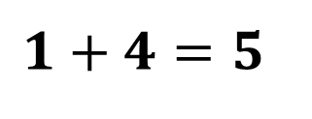
Patterns
Sample Problem 3: Find the common difference and the next number.
a.
$$1, 5, 9, 13, ……….$$
The pattern starts with 1 and continued by adding 4 to the last number each time. The common difference is 4
$$1+4=5$$
$$5+4=9$$
The next number is 17
$$9+4=13$$
$$13+4=17$$

Slide 15
Patterns
Sample Problem 3: Find the common difference and the next number.
b.
$$30, 25, 20, 15, ……….$$

Slide 16
Patterns
Sample Problem 3: Find the common difference and the next number.
b.
$$30, 25, 20, 15, ……….$$
The pattern starts with 30 and continued by adding -5 to the last number each time. The common difference is -5
$$30+(−5)=25$$
$$25+(−5)=20$$
The next number is 10
$$20+(−5)=15$$
$$15+(−5)=10$$

Slide 17
Patterns
Number Patterns
Geometric Patterns
Geometric patterns are sequences of numbers with patterns that are based on multiplication and division. In other words, as long as we know two or more numbers in the pattern, we can use either multiplication or division to find missing numbers. What we multiply by each time is called the common ratio.

Slide 18
Patterns
Sample Problem 4: Find the common ratio and the next number.
a.
$$1;6;36,;216;1,296;…………….$$

Slide 19
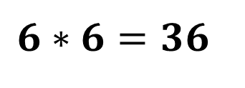
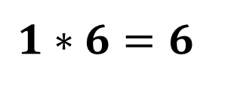
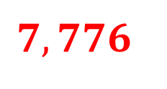
Patterns
Sample Problem 4: Find the common ratio and the next number.
a.
$$1;6;36,;216;1,296;…………….$$
The pattern starts with 1 and continued by multiplying by 6 to the last number each time. The common ratio is 6
$$1∗6=6$$
$$1,296∗6=7,776$$
$$6∗6=36$$
The next number is
$$7,776$$
$$36∗6=216$$
$$216∗6=1,296$$

Slide 20
Patterns
Sample Problem 4: Find the common ratio and the next number.
b.
$$24, 12, 6, 3, 1.5…………….$$

Slide 21
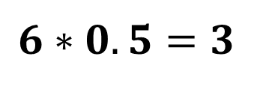
Patterns
Sample Problem 4: Find the common ratio and the next number.
b.
$$24, 12, 6, 3, 1.5…………….$$
The pattern starts with 24 and continued by multiplying by 0.5 to the last number each time. The common ratio is 0.5
$$24∗0.5=12$$
$$1.5∗0.5=0.75$$
$$12∗0.5=6$$
$$6∗0.5=3$$
The next number is $0.75$
$$3∗0.5=1.5$$

