Slide 1
Multiplying and Dividing Integers
Unit 1 Lesson 11

Slide 2
Multiplying and Dividing Integers
Students will be able to:
Multiply and divide integers using rules
Key Vocabulary:
An integer
Negative number
Positive number

Slide 3
Multiplying and Dividing Integers
Rules for Multiplying Integers
Rule 1:
If the integers have the same signs then the product will be positive.
$$\left(+\right)∗\left(+\right)=(+)$$
$\left(−\right)∗\left(−\right)=(+)$

Slide 4
Multiplying and Dividing Integers
Rules for Multiplying Integers
Rule 2:
If the integers have different signs then the product will be negative.
$$\left(−\right)∗\left(+\right)= \left(−\right)$$
$\left(+\right)∗\left(−\right)=\left(−\right)$

Slide 5
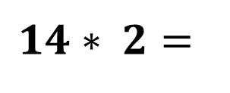
Multiplying and Dividing Integers
Sample Problem 1: Find the product of each expression below using the rules for multiplying integers.
a.
$$14∗ 2=$$

Slide 6
Multiplying and Dividing Integers
Sample Problem 1: Find the product of each expression below using the rules for multiplying integers.
a.
$$14∗ 2=28$$

Slide 7
Multiplying and Dividing Integers
Sample Problem 1: Find the product of each expression below using the rules for multiplying integers.
b.
$$\left(−10\right)∗\left(−4\right)=$$

Slide 8
Multiplying and Dividing Integers
Sample Problem 1: Find the product of each expression below using the rules for multiplying integers.
b.
$$\left(−10\right)∗\left(−4\right)=40$$

Slide 9
Multiplying and Dividing Integers
Sample Problem 1: Find the product of each expression below using the rules for multiplying integers.
c.
$$\left(−13\right)∗\left(−13\right)=$$

Slide 10
Multiplying and Dividing Integers
Sample Problem 1: Find the product of each expression below using the rules for multiplying integers.
c.
$$\left(−13\right)∗\left(−13\right)=169$$

Slide 11
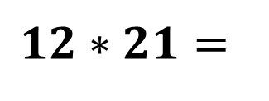
Multiplying and Dividing Integers
Sample Problem 1: Find the product of each expression below using the rules for multiplying integers.
d.
$$12∗21=$$

Slide 12
Multiplying and Dividing Integers
Sample Problem 1: Find the product of each expression below using the rules for multiplying integers.
d.
$$12∗21=252$$

Slide 13
Multiplying and Dividing Integers
Sample Problem 2: Find the product of each expression below using the rules for multiplying integers.
a.
$$\left(−13\right)∗14=$$

Slide 14
Multiplying and Dividing Integers
Sample Problem 2: Find the product of each expression below using the rules for multiplying integers.
a.
$$\left(−13\right)∗14=−182$$

Slide 15
Multiplying and Dividing Integers
Sample Problem 2: Find the product of each expression below using the rules for multiplying integers.
b.
$$18∗\left(−10\right)=$$

Slide 16
Multiplying and Dividing Integers
Sample Problem 2: Find the product of each expression below using the rules for multiplying integers.
b.
$$18∗\left(−10\right)=−180$$

Slide 17
Multiplying and Dividing Integers
Sample Problem 2: Find the product of each expression below using the rules for multiplying integers.
c.
$$\left(−7\right)∗22=$$

Slide 18
Multiplying and Dividing Integers
Sample Problem 2: Find the product of each expression below using the rules for multiplying integers.
c.
$$\left(−7\right)∗22=−154$$

Slide 19
Multiplying and Dividing Integers
Sample Problem 2: Find the product of each expression below using the rules for multiplying integers.
d.
$$100∗\left(−10\right)=$$

Slide 20
Multiplying and Dividing Integers
Sample Problem 2: Find the product of each expression below using the rules for multiplying integers.
d.
$$100∗\left(−10\right)=−1,000$$

Slide 21
Multiplying and Dividing Integers
Rules for Dividing Integers
Rule 1:
If the integers have the same signs then the quotient will be positive.
$$\left(+\right)÷\left(+\right)=\left(+\right) or \frac{\left(+\right)}{\left(+\right)}= \left(+\right)$$
$$\left(−\right)÷\left(−\right)=\left(+\right) or \frac{\left(−\right)}{\left(−\right)}= \left(+\right)$$

Slide 22
Multiplying and Dividing Integers
Rules for Dividing Integers
Rule 2:
If the integers have different signs then the quotient will be negative.
$$\left(−\right)÷\left(+\right)= \left(−\right) or \frac{\left(−\right)}{\left(+\right)}=\left(−\right)$$
$$\left(+\right)÷\left(−\right)= \left(−\right) or \frac{\left(+\right)}{\left(−\right)}=\left(−\right)$$

Slide 23
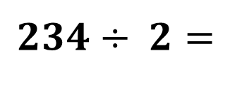
Multiplying and Dividing Integers
Sample Problem 3: Find the quotient of each expression below using the rules for dividing integers.
a.
$$234÷ 2=$$

Slide 24
Multiplying and Dividing Integers
Sample Problem 3: Find the quotient of each expression below using the rules for dividing integers.
a.
$$234÷ 2=117$$

Slide 25
Multiplying and Dividing Integers
Sample Problem 3: Find the quotient of each expression below using the rules for dividing integers.
b.
$$\left(−1,000\right)÷\left(−4\right)=$$

Slide 26
Multiplying and Dividing Integers
Sample Problem 3: Find the quotient of each expression below using the rules for dividing integers.
b.
$$\left(−1,000\right)÷\left(−4\right)=250$$

Slide 27
Multiplying and Dividing Integers
Sample Problem 3: Find the quotient of each expression below using the rules for dividing integers.
c.
$$\left(−196\right)÷\left(−14\right)=$$

Slide 28
Multiplying and Dividing Integers
Sample Problem 3: Find the quotient of each expression below using the rules for dividing integers.
c.
$$\left(−196\right)÷\left(−14\right)=14$$

Slide 29
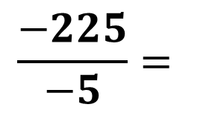
Multiplying and Dividing Integers
Sample Problem 3: Find the quotient of each expression below using the rules for dividing integers.
d.
$$\frac{−225}{−5}=$$

Slide 30
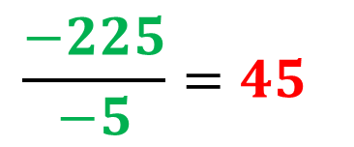
Multiplying and Dividing Integers
Sample Problem 3: Find the quotient of each expression below using the rules for dividing integers.
d.
$$\frac{−225}{−5}=45$$

Slide 31
Multiplying and Dividing Integers
Sample Problem 4: Find the quotient of each expression below using the rules for dividing integers.
a.
$$\left(−432\right)÷9=$$

Slide 32
Multiplying and Dividing Integers
Sample Problem 4: Find the quotient of each expression below using the rules for dividing integers.
a.
$$\left(−432\right)÷9=−48$$

Slide 33
Multiplying and Dividing Integers
Sample Problem 4: Find the quotient of each expression below using the rules for dividing integers.
b.
$$2,025÷\left(−45\right)=$$

Slide 34
Multiplying and Dividing Integers
Sample Problem 4: Find the quotient of each expression below using the rules for dividing integers.
b.
$$2,025÷\left(−45\right)=−45$$

Slide 35
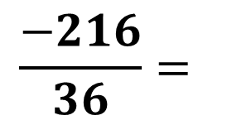
Multiplying and Dividing Integers
Sample Problem 4: Find the quotient of each expression below using the rules for dividing integers.
c.
$$\frac{−216}{36}=$$

Slide 36
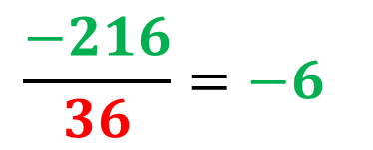
Multiplying and Dividing Integers
Sample Problem 4: Find the quotient of each expression below using the rules for dividing integers.
c.
$$\frac{−216}{36}=−6$$

Slide 37
Multiplying and Dividing Integers
Sample Problem 4: Find the quotient of each expression below using the rules for dividing integers.
d.
$$1,024÷\left(−16\right)=$$

Slide 38
Multiplying and Dividing Integers
Sample Problem 4: Find the quotient of each expression below using the rules for dividing integers.
d.
$$1,024÷\left(−16\right)=−64$$

Slide 39
Multiplying and Dividing Integers
Sample Problem 5: Solve each expression below.
a.
$$\left(−12\right)∗\left(−140\right)÷8=$$

Slide 40
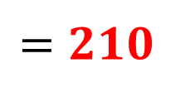
Multiplying and Dividing Integers
Sample Problem 5: Solve each expression below.
a.
$$\left(−12\right)∗\left(−140\right)÷8=$$
$$=1,680÷8=$$
$$=210$$

Slide 41
Multiplying and Dividing Integers
Sample Problem 5: Solve each expression below.
b.
$$128÷4∗(−14)=$$

Slide 42
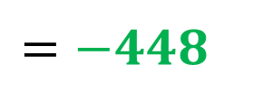
Multiplying and Dividing Integers
Sample Problem 5: Solve each expression below.
b.
$$128÷4∗(−14)=$$
$$=32∗(−14)=$$
$$=−448$$

Slide 43
Multiplying and Dividing Integers
Sample Problem 5: Solve each expression below.
c.
$$(−100)÷{\left[20÷(−10)\right]}^{2}=$$

Slide 44
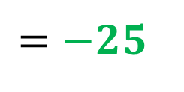
Multiplying and Dividing Integers
Sample Problem 5: Solve each expression below.
c.
$$(−100)÷{\left[20÷(−10)\right]}^{2}=$$
$$=(−100)÷{\left[−2\right]}^{2}=$$
$$=\left(−100\right)÷4=$$
$$=−25$$

Slide 45
Multiplying and Dividing Integers
Combined operations on integers

Slide 46
Multiplying and Dividing Integers
Sample Problem 6: Solve each expression below using order of operations.
a.
$$\left(−23\right)+\left[45+(−15)\right]∗\left(−14\right)−8=$$

Slide 47
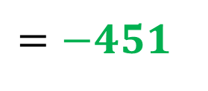
Multiplying and Dividing Integers
Sample Problem 6: Solve each expression below using order of operations.
a.
$$\left(−23\right)+\left[45+(−15)\right]∗\left(−14\right)−8=$$
$$=\left(−23\right)+\left[30\right]∗\left(−14\right)−8=$$
$$=\left(−23\right)+\left(−420\right)−8=$$
$$=\left(−443\right)−8=$$
$$=\left(−443\right)+(−8)=$$
$$=−451$$

Slide 48
Multiplying and Dividing Integers
Sample Problem 6: Solve each expression below using order of operations.
b.
$$28÷4+\left[225÷(−5)\right]−(−24)=$$

Slide 49
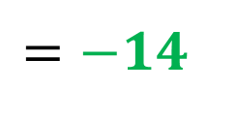
Multiplying and Dividing Integers
Sample Problem 6: Solve each expression below using order of operations.
b.
$$28÷4+\left[225÷(−5)\right]−(−24)=$$
$$=28÷4+\left[−45\right]−(−24)=$$
$$=7+\left[−45\right]−\left(−24\right)=$$
$$=−38−\left(−24\right)=$$
$$=−38+24=$$
$$=−14$$

Slide 50
Multiplying and Dividing Integers
Sample Problem 6: Solve each expression below using order of operations.
c.
$$\left(−10\right)∗{\left[1,200÷\left(−100\right)\right]}^{2}−\left[15÷(−3)\right]=$$

Slide 51
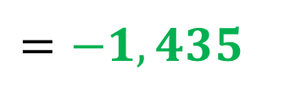
Multiplying and Dividing Integers
Sample Problem 6: Solve each expression below using order of operations.
c.
$$\left(−10\right)∗{\left[1,200÷\left(−100\right)\right]}^{2}−\left[15÷(−3)\right]=$$
$$=\left(−10\right)∗{\left[−12\right]}^{2}−\left[15÷(−3)\right]=$$
$=\left(−10\right)∗144−\left[−5\right]$=
$=−1,440−\left[−5\right]$=
$$=−1,440+5$$
$$=−1,435$$

