Slide 1
The Coordinate Plane
Unit 1 Lesson 12

Slide 2
The Coordinate Plane
Students will be able to:
Understand signs of numbers in ordered pairs as indicating locations in quadrants of the coordinate plane.
Find and position integers on a coordinate plane
Find and position pairs of integers on a coordinate plane.
Key Vocabulary:
Axis
Quadrants
Coordinates

Slide 3
The Coordinate Plane
A coordinate plane is formed by two number lines in a plane that intersect at right angles.
$$y$$
Quadrant II
5
Quadrant I
The point of intersection is the zero on each.
The two number lines are called the axis.
4
Origin
3
2
1
$$x$$
-5 -4 -3 -2 -1
0 1 2 3 4 5
-2
-3
-4
Quadrant III
Quadrant IV
-5

Slide 4
The Coordinate Plane
The horizontal axis is called the x-axis.
The vertical axis is called the y-axis.
$$y$$
The two axes divide the coordinate plane into four quadrants.
The point where the axes intersect is called the origin.
Quadrant II
5
Quadrant I
4
Origin
3
2
1
$$x$$
-5 -4 -3 -2 -1
0 1 2 3 4 5
-2
-3
-4
Quadrant III
Quadrant IV
-5

Slide 5
The Coordinate Plane
Sample Problem 1: Name the quadrant where each point is located.
$$y$$
a.
5
$$A$$
$$B$$
4
3
2
1
$$x$$
-5 -4 -3 -2 -1
0 1 2 3 4 5
-2
$$D$$
-3
-4
$$C$$
-5

Slide 6
The Coordinate Plane
Sample Problem 1: Name the quadrant where each point is located.
$$y$$
a.
$$A− Quadrant I$$
5
$$A$$
$$B$$
4
$$B −Quadrant II$$
3
2
$$C −Quadrant IV$$
1
$$x$$
$$D −Quadrant III$$
-5 -4 -3 -2 -1
0 1 2 3 4 5
-2
$$D$$
-3
-4
$$C$$
-5

Slide 7
The Coordinate Plane
Sample Problem 1: Name the quadrant where each point is located.
$$y$$
b.
5
$$N$$
4
3
$$K$$
2
1
$$x$$
-5 -4 -3 -2 -1
0 1 2 3 4 5
-2
$$M$$
-3
-4
$$J$$
-5

Slide 8
The Coordinate Plane
Sample Problem 1: Name the quadrant where each point is located.
$$y$$
b.
$$M−Quadrant III$$
5
$$N$$
4
$$N −Quadrant I$$
3
$$K$$
2
1
$$K −Quadrant II$$
$$x$$
-5 -4 -3 -2 -1
0 1 2 3 4 5
-2
$$J − Quadrant IV$$
$$M$$
-3
-4
$$J$$
-5

Slide 9
The Coordinate Plane
An ordered pair gives the location of a point on a coordinate plane.
The first number tells how far to move right (positive) or left (negative) from the origin.
The second number tells how far to move up (positive) or down (negative).

Slide 10
The Coordinate Plane
The numbers in an ordered pair are called coordinates.
The first number is called the x-coordinate.
The second number is called the y-coordinate.
The ordered pair for the origin is (0,0).

Slide 11
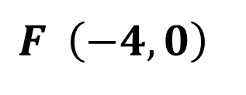
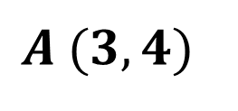
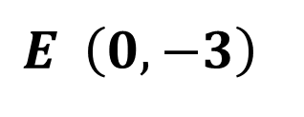
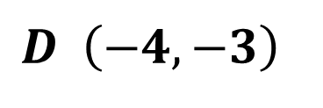
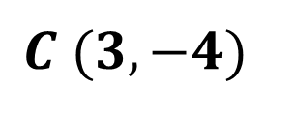
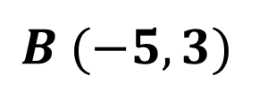
The Coordinate Plane
Sample Problem 2: Graph each point on a coordinate plane.
a.
$$A (3,4)$$
$$B (−5,3)$$
$$C (3,−4)$$
$$D \left(−4,−3\right)$$
$$E \left(0,−3\right)$$
$$F \left(−4,0\right)$$

Slide 12
The Coordinate Plane
Sample Problem 2: Graph each point on a coordinate plane.
$$y$$
a.
$$A (3,4)$$
5
$$A$$
$$B (−5,3)$$
$$B$$
4
3
$$C (3,−4)$$
2
$$F$$
1
$$D \left(−4,−3\right)$$
$$x$$
-5 -4 -3 -2 -1
0 1 2 3 4 5
-2
$$E \left(0,−3\right)$$
$$E$$
-3
$$D$$
-4
$$C$$
$$F \left(−4,0\right)$$
-5

Slide 13
The Coordinate Plane
Sample Problem 3: Give the coordinates of each point.
$$y$$
a.
5
$$L$$
$$K$$
4
3
2
$$M$$
1
-5 -4 -3 -2 -1
0 1 2 3 4 5
$$x$$
-2
$$P$$
$$R$$
-3
-4
$$T$$
-5

Slide 14
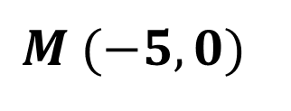
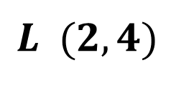
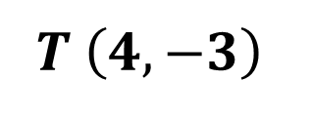
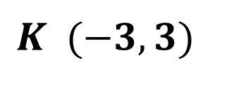
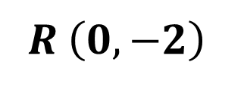
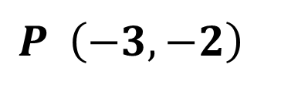
The Coordinate Plane
Sample Problem 3: Give the coordinates of each point.
$$y$$
a.
5
$$L$$
$$K (−3,3)$$
$$K$$
4
3
$$L (2,4)$$
2
$$M$$
1
$$M (−5,0)$$
-5 -4 -3 -2 -1
0 1 2 3 4 5
$$x$$
-2
$$P \left(−3,−2\right)$$
$$P$$
$$R$$
-3
-4
$$T$$
$$R \left(0,−2\right)$$
-5
$$T \left(4,−3\right)$$

Slide 15
The Coordinate Plane
Finding Segment Lengths and Area
Sample Problem 4: Graph each point on a coordinate plane and find the line segment lengths.
a.
$$A\left(−1,4\right) and B\left(−4,4\right)$$
$$G\left(3,0\right) and T\left(3,−5\right)$$
$$C\left(−4,−5\right) and K(−4,−2)$$

Slide 16
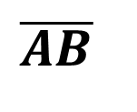
The Coordinate Plane
Sample Problem 4: Graph each point on a coordinate plane and find the line segment lengths.
$$y$$
a.
$$\overline{AB}$$
is horizontal
$$B$$
$$A$$
5
4
$$\overline{AB}=\left|difference of x−coordinates\right|$$
3
2
$$\overline{AB}=\left|−1−(−4)\right|=\left|−1+4\right|=3$$
1
$$x$$
$$\overline{AB}=3 units$$
-5 -4 -3 -2 -1
0 1 2 3 4 5
-2
-3
-4
-5

Slide 17
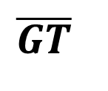
The Coordinate Plane
Sample Problem 4: Graph each point on a coordinate plane and find the line segment lengths.
$$y$$
a.
$$\overline{GT}$$
is vertical
5
4
$$\overline{GT}=\left|difference of y−coordinates\right|$$
3
2
$$\overline{GT}=\left|0−(−5)\right|=\left|0+5\right|=5$$
1
$$G$$
$$x$$
$$\overline{GT}=5 units$$
-5 -4 -3 -2 -1
0 1 2 3 4 5
-2
-3
-4
$$T$$
-5

Slide 18
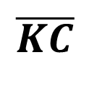
The Coordinate Plane
Sample Problem 4: Graph each point on a coordinate plane and find the line segment lengths.
$$y$$
a.
$$\overline{KC}$$
is vertical
5
4
$$\overline{KC}=\left|difference of y−coordinates\right|$$
3
2
$$\overline{KC}=\left|−5−(−2)\right|=\left|−5+2\right|=3$$
1
$$x$$
$$\overline{KC}=3 units$$
-5 -4 -3 -2 -1
0 1 2 3 4 5
-2
$$K$$
-3
-4
$$C$$
-5

Slide 19
The Coordinate Plane
Sample Problem 5: Graph each point on a coordinate plane and find the area of the figure.
a.
$$A \left(3,4\right), B \left(−4,4\right), C\left(−4,−5\right) and D\left(3,−5\right)$$

Slide 20
The Coordinate Plane
Sample Problem 5: Graph each point on a coordinate plane and find the area of the figure.
$$y$$
a.
$$\overline{AB}$$
horizontal
5
$$B$$
4
$$A$$
$$\overline{AB}=\left|difference of x−coordinates\right|$$
3
2
$$\overline{AB}=\left|3−(−4)\right|=\left|3+4\right|=7$$
1
$$x$$
$$\overline{AB}=7 units$$
-5 -4 -3 -2 -1
0 1 2 3 4 5
-2
-3
-4
$$C$$
-5
$$D$$

Slide 21
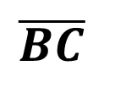
The Coordinate Plane
Sample Problem 5: Graph each point on a coordinate plane and find the area of the figure.
$$y$$
a.
$$\overline{BC}$$
is vertical
5
$$B$$
4
$$A$$
$$\overline{BC}=\left|difference of y−coordinates\right|$$
3
2
$$\overline{BC}=\left|4−(−5)\right|=\left|4+5\right|=9$$
1
$$x$$
$$\overline{BC}=9 units$$
-5 -4 -3 -2 -1
0 1 2 3 4 5
-2
-3
-4
$$C$$
-5
$$D$$

Slide 22
The Coordinate Plane
Sample Problem 5: Graph each point on a coordinate plane and find the area of the figure.
$$y$$
a.
Rectangle
5
$$B$$
4
$$A$$
3
$$A=\overline{AB}∗\overline{BC}$$
2
1
$$A=7 units∗9 units$$
$$x$$
-5 -4 -3 -2 -1
0 1 2 3 4 5
-2
$$A=63{ units}^{2}$$
-3
-4
$$C$$
-5
$$D$$

